Slide 1

ALGEBRA
Math 10-3

Slide 2
LESSON 6
EQUATIONS

Slide 3
EQUATIONS
An equation is a statement about the equality of two expressions.
If either of the expressions contains a variable, the equation may be a true statement for some values of the variable and a false statement for other values.
For example, the equation 2x + 1 = 7 is a true statement for x = 3, but it is false for any number except 3.

Slide 4
EQUATIONS
The number 3 is said to satisfy the equation 2x + 1 = 7 because substituting 3 for x produces 2(3) + 1 = 7, which is a true statement.
To solve an equation means to find all values of the variable that satisfy the equation.
The values that satisfy an equation are called solutions or roots of the equation.
For instance, 2 is a solution of x + 3 = 5.

Slide 5
EQUATIONS
Equivalent equations are equations that have exactly the same solution or solutions.
The process of solving an equation is often accomplished by producing a sequence of equivalent equations until we arrive at an equation or equations of the form
Variable = Constant
To produce these equivalent equations, apply the properties of real numbers and the following two properties of equality.

Slide 6
PROPERTIES OF EQUALITY

Slide 7
PROPERTIES OF EQUALITY
Addition and Subtraction Property of Equality
Adding the same expression to each side of an equation or subtracting the same expression from each side of an equation produces an equivalent equation.
If a = b then a + c = b + c or If a = b then a – c = b – c
EXAMPLE
Begin with the equation 2x – 7 = 11.
Replacing x with 9 shows that 9 is a solution of the equation. Now add 7 to each side of the equation.
The resulting equation is 2x = 18, and the solution of the new equation is still 9.

Slide 8

PROPERTIES OF EQUALITY
Multiplication and Division Property of Equality
Multiplying or dividing each side of an equation by the same nonzero expression produces an equivalent equation.
If a = b then a ∙ c = b ∙ c or If a =b then
EXAMPLE
Begin with the equation x = 8.
Replacing x with 12 shows that 12 is a solution of the equation. Now multiply each side of the equation by .
The resulting equation is x = 12, and the solution of the new equation is still 12.

Slide 9
LINEAR EQUATIONS

Slide 10
LINEAR EQUATIONS
Many applications can be modeled by linear equations in one variable.
Definition of a Linear Equation
A linear equation, or first-degree equation, in the single variable x is an equation that can be written in the form
ax + b = 0
where a and b are real numbers, with a ≠ 0.
Linear equations are solved by applying the properties of real numbers and the properties of equality.

Slide 11
LINEAR EQUATIONS | NONLINEAR EQUATIONS
Nonlinear; contains the square root of the variable
Nonlinear; contains the square root of the variable
Nonlinear; contains the reciprocal of the variable

Slide 12
BASIC STEPS TO SOLVE LINEAR EQUATION
Eliminate fractions by multiplying each member of the
equation by the lowest common denominator.
2. Remove symbols of grouping.
3. Isolate all terms containing the variable on one side of
the equation and all the other terms on the opposite
side. Simplify by combining like terms.
4. Divide both sides of the equation by the coefficient of
the variable.
5. Check the solution by substituting the value of the
unknown into the original equation.
In cases wherein the variable appears under a radical sign, the
radicals should first be cleared of in the equation and then follow
the basics steps in solving linear equation.

Slide 13
SOLVE A LINEAR EQUATION IN ONE VARIABLE
EXAMPLE
Solve: 3x – 5 = 7x – 11
Solution:
3x – 5 = 7x – 11
3x – 7x – 5 = 7x – 7x – 11
–4x – 5 = –11
–4x – 5 + 5 = –11 + 5
–4x = –6
Subtract 7x from each side of the equation.
Add 5 to each side of the equation.

Slide 14

cont’d
The solution is .
Divide each side of the equation by –4.
The equation is now in the form
Variable = Constant.

Slide 15
LINEAR EQUATIONS
When an equation contains parentheses, use the distributive property to remove the parentheses.
If an equation involves fractions, it is helpful to multiply each side of the equation by the least common denominator (LCD) of all denominators to produce an equivalent equation that does not contain fractions.

Slide 16
SOLVE A LINEAR EQUATION IN ONE VARIABLE
Solve each equations.
EXTRANEOUS ROOT
An extraneous root is a root of the derived equation but not the
root of the original equation.

Slide 17
CONTRADICTIONS, CONDITIONAL EQUATIONS,
AND IDENTITIES

Slide 18
CONTRADICTIONS, CONDITIONAL EQUATIONS,
AND IDENTITIES
An equation that has no solutions is called a contradiction or inconsistent equation.
The equation x = x + 1 is a contradiction. No number is equal to itself increased by 1.
An equation that is true for some values of the variable but not true for other values of the variable is called a conditional equation. For example, x + 2 = 8 is a conditional equation because it is true for x = 6 and false for any number not equal to 6.

Slide 19
CONTRADICTIONS, CONDITIONAL EQUATIONS,
AND IDENTITIES
An identity is an equation that is true for all values of the variable for which all terms of the equation are defined.
Examples of identities include the equations
x + x = 2x and 4(x + 3) – 1 = 4x + 11.

Slide 20
CLASSIFY EQUATIONS
Classify each equation as a contradiction, a conditional equation, or an identity.
a. x + 1 = x + 4
b. 4x + 3 = x – 9
c. 5(3x – 2) – 7(x – 4) = 8x + 18

Slide 21
SOLUTION
a. Subtract x from both sides of x + 1 = x + 4 to produce the equivalent equation 1 = 4.
Because 1 = 4 is a false statement, the original equation x + 1 = x + 4 has no solutions.
It is a contradiction.
b. Solve using the procedures that produce equivalent equations. 4x + 3 = x – 9

Slide 22
SOLUTION
cont’d
3x + 3 = –9
3x = –12
x = –4
Check to confirm that –4 is a solution.
The equation 4x + 3 = x – 9 is true for x = –4, but it is not true for any other values of x.
Thus 4x + 3 = x – 9 is a conditional equation.
Subtract x from each side.
Subtract 3 from each side.
Divide each side by 3.

Slide 23
SOLUTION
cont’d
c. Simplify the left side of the equation to show that it is identical to the right side.
5(3x – 2) – 7(x – 4) = 8x + 18
15x – 10 – 7x + 28 = 8x + 18
8x + 18 = 8x + 18
The original equation 5(3x – 2) – 7(x – 4) = 8x + 18 is true for all real numbers x.
The equation is an identity.

Slide 24
Classify each equation as a contradiction, a conditional equation, or an identity.

Slide 25
ABSOLUTE VALUE EQUATIONS

Slide 26
ABSOLUTE VALUE EQUATIONS
DEFINITION The absolute value of a number a is given by

Slide 27
ABSOLUTE VALUE EQUATIONS
The absolute value of a real number x is the distance between the number x and the number 0 on the real number line.
Thus the solutions of | x | = 3 are all real numbers that are
3 units from 0.
Therefore, the solutions of | x | = 3 are x = 3 or x = –3. See Figure 1.1.
| x | = 3
Figure 1.1

Slide 28
ABSOLUTE VALUE EQUATIONS
The following property is used to solve absolute value equations.
A Property of Absolute Value Equations
For any variable expression E and any nonnegative real number k,
| E | = k if and only if E = k or E = –k

Slide 29
ABSOLUTE VALUE EQUATIONS
EXAMPLE
If | x | = 5, then x = 5 or x = –5.
If | x | = , then x = or x = – .
If | x | = 0, then x = 0.

Slide 30
SOLVE AN ABSOLUTE VALUE EQUATION
Solve: | 2x – 5 | = 21
Solution:
| 2x – 5 | = 21 implies 2x – 5 = 21 or 2x – 5 = –21.
Solving each of these linear equations produces
2x – 5 = 21 or 2x – 5 = –21
2x = 26 2x = –16
x = 13 x = –8
The solutions are –8 and 13.

Slide 31
SOLVE EACH EQUATIONS

Slide 32
FORMULAS

Slide 33
FORMULAS
A formula is an equation that expresses known relationships between two or more variables.
Many formulas in the sciences involve several variables, and it is often necessary to express one of the variables in terms of the others.
Table 1.2 lists several formulas from geometry.
The variable P represents perimeter, C represents circumference of a circle, A represents area, S represents surface area of an enclosed solid, and V represents volume.

Slide 34
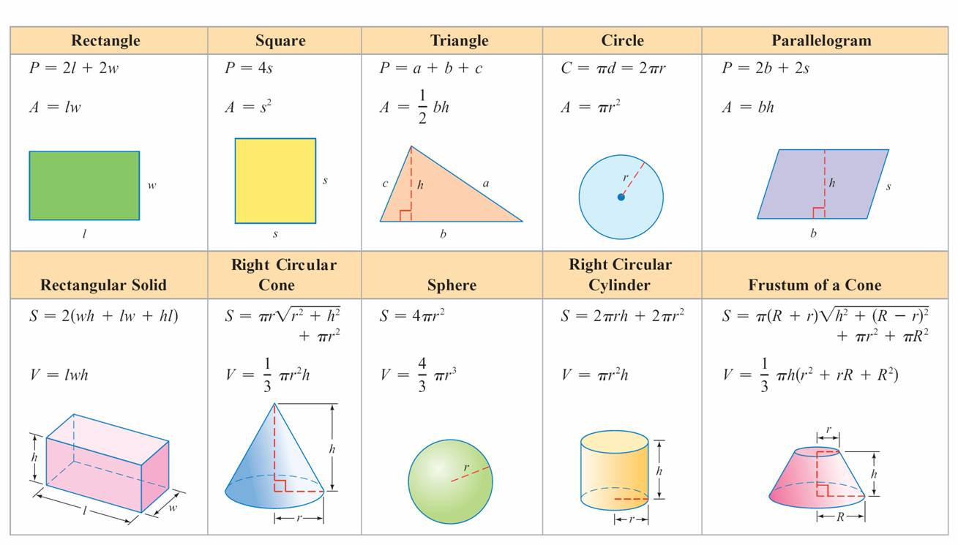
FORMULAS
Table 1.2
Formulas from Geometry

Slide 35
FORMULAS
It is often necessary to solve a formula for a specified variable.
Begin the process by isolating all terms that contain the specified variable on one side of the equation and all terms that do not contain the specified variable on the other side.

Slide 36
SOLVE A FORMULA FOR A SPECIFIED VARIABLE
EXAMPLE
a. Solve 2l + 2w = P for l.
b. Solve S = 2(wh + lw + hl) for h.
Solution:
a. 2l + 2w = P
2l = P – 2w
Subtract 2w from each side to isolate the 2l term.
Divide each side by 2.

Slide 37
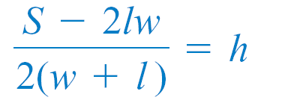
SOLVE A FORMULA FOR A SPECIFIED VARIABLE
cont’d
b. S = 2(wh + lw + hl)
S = 2wh + 2lw + 2hl
S – 2lw = 2wh + 2hl
S – 2lw = 2h(w + l)
Isolate the terms that involve the variable h on the right side.
Factor 2h from the right side.
Divide each side by 2(w + l ).

Slide 38
SOLVE A FORMULA FOR A SPECIFIED VARIABLE
EXAMPLE

Slide 39
APPLICATIONS OF LINEAR EQUATIONS

Slide 40
MODELLING WITH EQUATIONS .
Linear equations often can be used to model real-world data.

Slide 41
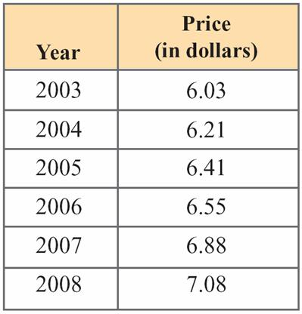
MOVIE THEATER TICKET PRICES
Movie theater ticket prices have been increasing steadily in recent years (see Table 1.1).
Table 1.1
Average U.S. Movie Theater Ticket Price
Source: National Association of Theatre Owners, http:/www.natoonline.org/statisticstickets.htm.

Slide 42
MOVIE THEATER TICKET PRICES
cont’d
An equation that models the average U.S. movie theater
ticket price p, in dollars, is given by
p = 0.211t + 5.998
where t is the number of years after 2003. (This means that t = 0 corresponds to 2003.) Use this equation to predict the year in which the average U.S. movie theater ticket price will reach $7.50.

Slide 43
SOLUTION
cont’d
p = 0.211t + 5.998
7.50 = 0.211t + 5.998
1.502 = 0.211t
t ≈ 7.1
Our equation predicts that the average U.S. movie theater ticket price will reach $7.50 about 7.1 years after 2003, which is 2010.
Substitute 7.50 for p.
Solve for t.

Slide 44
APPLICATIONS

Slide 45
APPLICATIONS
Linear equations emerge in a variety of application problems. In solving such problems, it generally helps to apply specific techniques in a series of small steps.
Strategies for Solving Application Problems
1. Read the problem carefully. If necessary, reread the problem several times.
2. When appropriate, draw a sketch and label parts of the drawing with the specific information given in the problem.

Slide 46
APPLICATIONS
3. Determine the unknown quantities, and label them with variables. Write down any equation that relates the variables.
4. Use the information from step 3, along with a known formula or some additional information given in the problem, to write an equation.
5. Solve the equation obtained in step 4, and check to see whether the results satisfy all the conditions of the original problem.

Slide 47
GEOMETRY PROBLEM
One of the best known paintings is the Mona Lisa by
Leonardo da Vinci. It is on display at the Musée du Louvre,
in Paris. The length (or height) of this rectangular-shaped
painting is 24 centimeters more than its width. The perimeter of the painting is 260 centimeters. Find the width
and length of the painting.

Slide 48
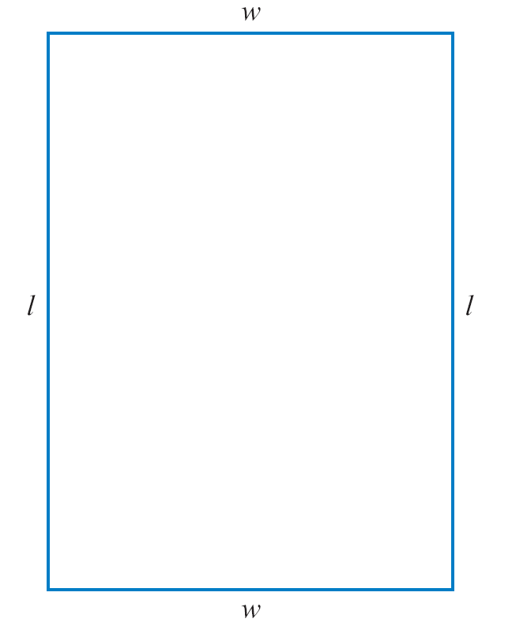
SOLUTION
1. Read the problem carefully.
2. Draw a rectangle. See Figure 1.3.
3. Label the rectangle. We have used w for its width and l for its length. The problem states that the length is 24 centimeters more than the width. Thus l and w are related by the equation
l = w + 24
Figure 1.3

Slide 49
4. The perimeter of a rectangle is given by the formula P = 2l + 2w. To produce an equation that involves only constants and a single variable (say, w), substitute 260 for P and w + 24 for l.
P = 2l + 2w
260 = 2(w + 24) + 2w
5. Solve for w.
260 = 2w + 48 + 2w
260 = 4w + 48
cont’d

Slide 50
212 = 4w
w = 53
The length is 24 centimeters more than the width.
Thus
l = 53 + 24 = 77.
A check verifies that 77 is 24 more than 53 and that twice the length (77) plus twice the width (53) gives the perimeter (260).
The width of the painting is 53 centimeters, and its length is 77 centimeters.
cont’d

Slide 51
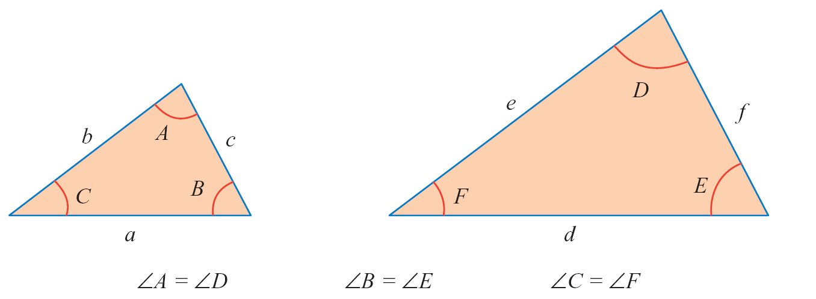
GEOMETRY PROBLEMS
Similar triangles are ones for which the measures of corresponding angles are equal. The triangles below are similar.

Slide 52
GEOMETRY PROBLEMS
An important relationship among the sides of similar triangles is that the ratios of corresponding sides are equal.
Thus, for the triangles,
This fact is used in many applications.

Slide 53
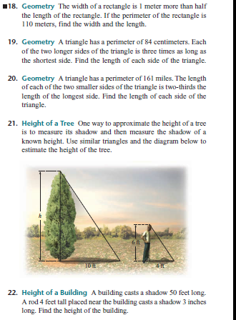
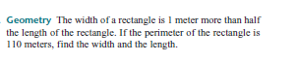
GEOMETRY PROBLEMS
1.
2.

Slide 54
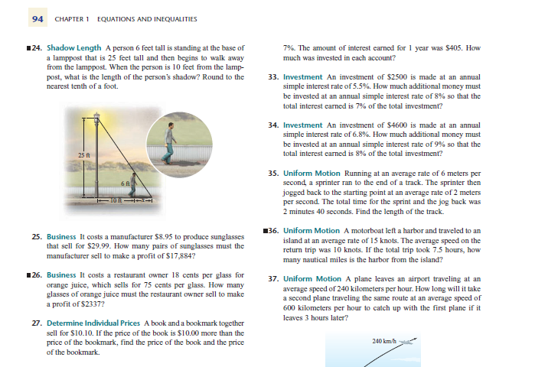
GEOMETRY PROBLEMS
3.

Slide 55
NUMBER and DIGIT PROBLEM
The sum of digits of two digit number is 12. If the new number formed by reversing the digits is less than the original number by 54 .Find the original number.
The tens digit of a two-digit number exceeds the units digit by 2. The sum of the tens digit and twice the units digit is 17. Find the number .
The units digit of a two-digit number exceeds three times the tens digit by 3. If the tens digit is subtracted from the units digit, the difference is 7. Find the number.

Slide 56
NUMBER and DIGIT PROBLEM
During the last election , the total number of votes recorded in the municipality of San Juan was 8600. Had one-third of Estrada’s supporters stayed away from the polls and one-half of Arroyo’s behaved likewise , Estrada’s majority would have been reduced by 200.
How many votes did Estrada actually received?
How many votes did Arroyo actually received?
Determine Estrada’s new majority over Arroyo when both their supporters stayed away from the polls.

Slide 57
INVESTMENT PROBLEMS
Many business applications can be solved by using the equation
Profit = revenue – cost
Simple interest problems can be solved by using the formula I = Prt, where I is the interest, P is the principal, r is the simple interest rate per period, and t is the number of periods.

Slide 58
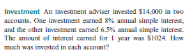
INVESTMENT PROBLEMS
1.
2.

Slide 59
INVESTMENT PROBLEMS
A bookstore purchased a best selling book priced at P200 per copy.
At what price should this book be sold so that giving a 20% discount, the profit is 30%.
The average salary for bus drivers in a private school between 1975
and 1989 can be approximated by the linear model y=5.45 + 0.366t
where y represents the salary in pesos per hour and t represents the year with t=0 corresponding to 1980.
During what year was the average salary equal to P7.28/hour?
What is the average salary at the year 1976?
What was the average annual raise for the bus drivers during
this 15 years period?

Slide 60
AGE PROBLEMS
The present age of Jacob’s father is three times that of Jacob. After 5 years, sum of their ages would be 70 years. Find their present ages.
Jack will be 48 years old after 5 years. In 10 years, the sum of the ages of Jack and Peter will be 90.How old is Peter right now?
A is as old as the combined ages of his two brothers B and C . But C is two years older than B. The combined ages of the three last year was ¾ the combined ages at present . How old is B now?

Slide 61
AGE PROBLEMS
Peter is 20 years old and his brother is 4 years old. In how many years will Peter be twice as old as his brother?
Jason’s age is one year less than twice Jonas’ age. Jason’s
age last year is the same as Jonas’ age 6 years from now.
How old are they now?

Slide 62
UNIFORM MOTION PROBLEMS
Many uniform motion problems can be solved by using the formula d = rt, where d is the distance traveled, r is the rate of speed, and t is the time.

Slide 63
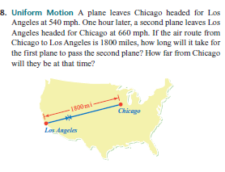
UNIFORM MOTION PROBLEMS
1.

Slide 64
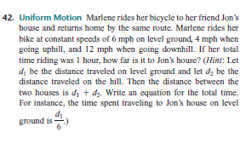
UNIFORM MOTION PROBLEMS
2.

Slide 65
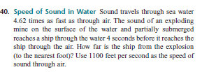
UNIFORM MOTION PROBLEMS
3.
4. Moving upstream, a motor boat travels at a certain distance
of the river for 45 seconds. Going back, the same motor
boat travels the same distance for 20 seconds. If the river
current remains the same at 5 m/s, how fast is the motor
boat at still water?

Slide 66
MIXTURE PROBLEMS
Percent mixture problems involve combining solutions or alloys that have different concentrations of a common substance.
Percent mixture problems can be solved by using the formula pA = Q, where p is the percent of concentration (in decimal form), A is the amount of the solution or alloy, and Q is the quantity of a substance in the solution or alloy.

Slide 67
MIXTURE PROBLEMS
For example, in 4 liters of a 25% acid solution, p is the percent of acid (0.25 as a decimal), A is the amount of solution (4 liters), and Q is the amount of acid in the solution, which equals (0.25)(4) liters = 1 liter.
Value mixture problems involve combining two or more ingredients that have different prices into a single blend.
The solution of a value mixture problem is based on the equation V = CA, where V is the value of the ingredient, C is the unit cost of the ingredient, and A is the amount of the ingredient.

Slide 68
MIXTURE PROBLEMS
For instance, if the cost C of tea is $4.30 per pound, then 5 pounds (the amount A) of tea has a value V = (4.30)(5) = 21.50, or $21.50.
The solution of a value mixture problem is based on the sum of the values of all ingredients taken separately equaling the value of the mixture.

Slide 69
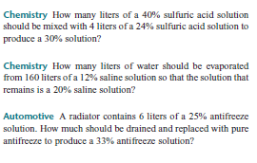
MIXTURE PROBLEMS
1.
2.
3.

Slide 70


MIXTURE PROBLEMS
4.
5.

Slide 71

WORK PROBLEMS
To solve a work problem, use the equation
Rate of work × time worked = part of task completed
For example, if a painter can paint a wall in 15 minutes,
then the painter can paint of the wall in 1 minute.
The painter’s rate of work is of the wall each minute.
In general, if a task can be completed in x minutes, then
the rate of work is of the task each minute.

Slide 72
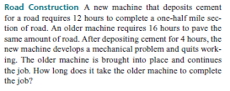
WORK PROBLEMS
1.

Slide 73
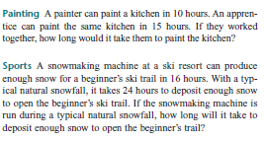
WORK PROBLEMS
2.
3.

Slide 74
WORK PROBLEMS
Sarah works twice as fast as Rachel on a certain type of job. If they will be working together, they can finish a job in 8 days. How long will it take for each of them to finish the job.
A 3 men maintenance crew can repaint an antenna tower in 72 hours whereas another crew of 5 men can repaint the same tower in half the time. If the company desires to hire both crews, how long will it take the two crews to repaint the tower together?
Eight men can excavate 15 cu. m. of drainage open canal in 7 hours. Three men can backfill 10 cu.m. In 4 hours. How long will it take 10 men to excavate and back fill 20 cu.m. In the same project?

Slide 75
CLOCK PROBLEMS
One space in the clock is equivalent to 5 minutes.
If the minute hand moves a distance “x” , the hour hand moves only a distance of “x/12” .
One space in the clock is equivalent to 30 degrees of arc.

Slide 76
CLOCK PROBLEMS
What time after 3:00 pm will the hands of the continuously driven clock are together for the first time?
What time after 4 o’ clock will the hands of the continuously driven clock from a right angle?
At how many minutes after 3PM will the hands of the clock be.
together for the first time
opposite each other for the first time
perpendicular to each other for the first time.
Notes:
What time after 8 o’ clock will the hands of the continuously driven clock be opposite each other?
What time after 5:00 am will the hands of the continuously driven clock extend in opposite direction?
What time

Slide 77
CLOCK PROBLEMS
It is now between 9 and 10 o’clock .
At what time after 9 o’clock will the minute hand and the hour hand be perpendicular for the first time.
In 4 minutes , the hour hand will be directly opposite the position occupied by the minute hand 3 minutes ago. What time is it?
In a quarter of an hour the minute hand will be behind the hour hand by only half as much as it is now behind it. What time is it?
What time after 5:00 am will the hands of the continuously driven clock extend in opposite direction?
Notes:
What time after 8 o’ clock will the hands of the continuously driven clock be opposite each other?
What time after 5:00 am will the hands of the continuously driven clock extend in opposite direction?
What time

